Slide 1
Artificial intelligence VI
Maria Markosova

Slide 2
Last lecture
Exact inference in Bayesian networks.
Probabilistic inference in Bayesian networks by sampling.
Direct sampling in Bayesian nets.
Rejection sampling in Bayesian nets.
Likelyhood weighting.
B. networks in use.

Slide 3
More complex classifier
Bayesian classifier
Category
client Earnings Account Gender Unemployed Loan
Vocabulary
klient client
prijem earnings
konto account
pohlavie gender
nezamestnanost
unemployment
uver loan
1 high high f n y
2 high high m n y
3 small small m n n
4 middle high f y y
5 small high m y y
6 small small f y n
7 high small m n y
8 high small f y y
9 small middle m y n
10 high middle f n y
11 small middle f y n
12 small middle m n y

Slide 4
Expert defined, that the Bayessian classifier is
Gender
Unemployed.
Account
Earning
Loan

Slide 5
P(f}
P(unemp)
Gender
Unemp.
P(Earn=small/Gen,Unemp)
Account
Genderl Une
Earning
1=f 1
1 0
0 1
0 0
1/4
P(high) P(middle) P(small)
4/12 | 4/12 | 4/12
Loan
1- f, 0 - m
Fill the tabs from the training data!
P(Earn=high/Gender, Unempl)
P(Earn=middle/Gender,Unempl)

Slide 6
Write Bayes net rule for this network?
$$P\left(Gend, Unemp, Earn, Account, Loan\right)=P\left(Gend\right)P\left(Unemp\right)P\left(Account\right)P\left(Earn /Gen, Unemp\right) P\left(Loan/ Earn,Unemp,Account\right)$$
What is the probability for this atomic event ?
$$P\left(Gen=f, Unemp=y,Earning=middle, Account=high, Loan=n\right)$$
Using previous formula , the probabilities are estimated from the test data.
We can ask another questions
$$P\left(Earn=high / Gender=f, Unempl=y\right)$$
$$P\left(Loan/ Gender=f, Unempl=y,Earn=small, Account=middle\right)$$
The second question is a classification question. Will the person get loan providing that the person is an unemployed woman, with low allowance and average money on the bank account.

Slide 7
Example calculations on Bayesian classifier
What is the probability for this atomic event ?
P(Gend=f, Unemp=y, Earning=middle, Account=high, Loan=y
Comment: use Bayes net rule here
P(Gend=f, Unemp=y, Earning=middle, Account=high, Loan=y)=
=P(Gender=f)P(Unemp=y)P(Account=high)P(Earning=middle/Gender=f, Unemp=y)P(Loan=y/Earn=middle, Unemp=y, Account=high)
Above the atomic event is described with a help of the Bayes net rule. Now we estimate probabilities with a help of the training data.
P(Gender=f)=6/12 = ½, P(Account=high)=4/12 = 1/3, P(Unemp=y)=6/12 = ½,
P(Earning=middle/Gender=f,Unemp=yes)=1/4
P(Loan=y/Earning=middle, Unemp=y, Account=high)=1.0

Slide 8
Diagnostics of the failed robot
NU
SW
HW
MRL
MVN
NS
U
IP
NU – unexpected event (nečakaná udalosť), SW –software problem (softwerovy problém), HW -hardware problem (hardvérový problém), NS – nonsense signal (nezmyselný signál) to other robots, U – attack (útok) on other robots, IP – robot ignors orders (ignoruje príkazy), MRL language and inference modul (modul spracujuci jazyk) , MVN – perceipt elaboration modul (modul spracujúci vnemy)

Slide 9
All variables are Boolean.
NU
SW
HW
MRL
MVN
NS
U
IP

Slide 10
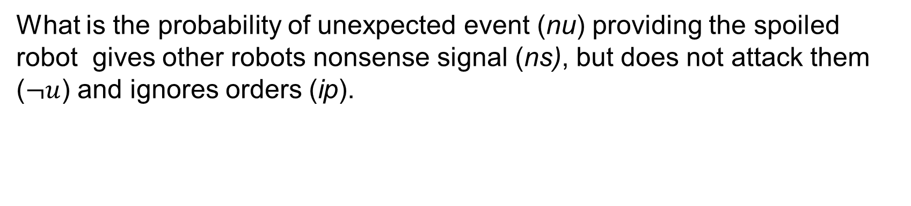
What is the probability of unexpected event (nu) providing the spoiled robot gives other robots nonsense signal (ns), but does not attack them ($¬u$) and ignores orders (ip).
What is the probability, that robot ignores orders (ip), providing there is a software problem (sw).
What is the probability that he robot ignores orders (ip), providing there are both software and hardware problem (sw, hw).
Answer these questions at home

Slide 11
Movie recommendation system
Bayesian networks are used in recommendation systems, where they help to recommend
Movies
Goods
Books
Holyday resorts etc
These recommendation systems contain a lot of random variables and take into account a lot of
values. Therefore they need a large training sets to estimate all conditional probabilities.

Slide 12
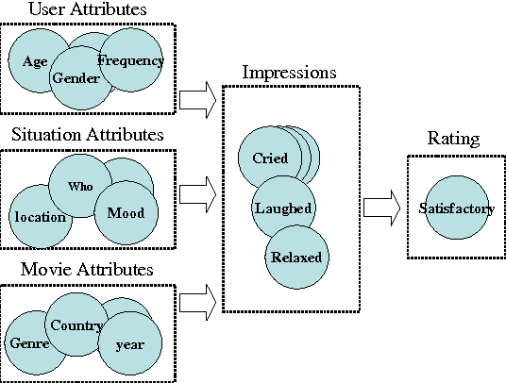
In the movie recommendation system, there are a lot of attributes concerning users, the others concerning context, situations, and then there are movie attributes, All this influences impressions and impressions influence movie rating. According this rating the systems recommends other similar movies.

Slide 13
Outline
D – separation in Bayesian network
Time series introduction
Types of time series
Trend in time series

Slide 14
d – separation algorithm in Bayesian networks
d – separation algorithm in a graph is a technique enabling one to find an independent or conditionally independent nodes without too much calculations.
In Bayesian network d - separation technique makes inference more easy, because it identifies more independent and conditionaly independent nodes then those used in the simplifying chain rule.
For example:
Are A and B conditionally independent, given D and F? (Same as “P(A|B,D,F) =? P(A|D,F)” or “P(B|A,D,F) =? P(B|D,F)”)
Are A and B independent? (Same as “P(A|B) =? P(A)” or “P(B|A) =? P(B)”)
3. Are A and B conditionally independent,
given C?
4. Are D and E conditionally independent,
given C?
Are D and E independent?
Are D and E conditionally independent, given A and B?
P(D|B,C,E) =? P(D|C)
A B
C
D E
F
G

Slide 15
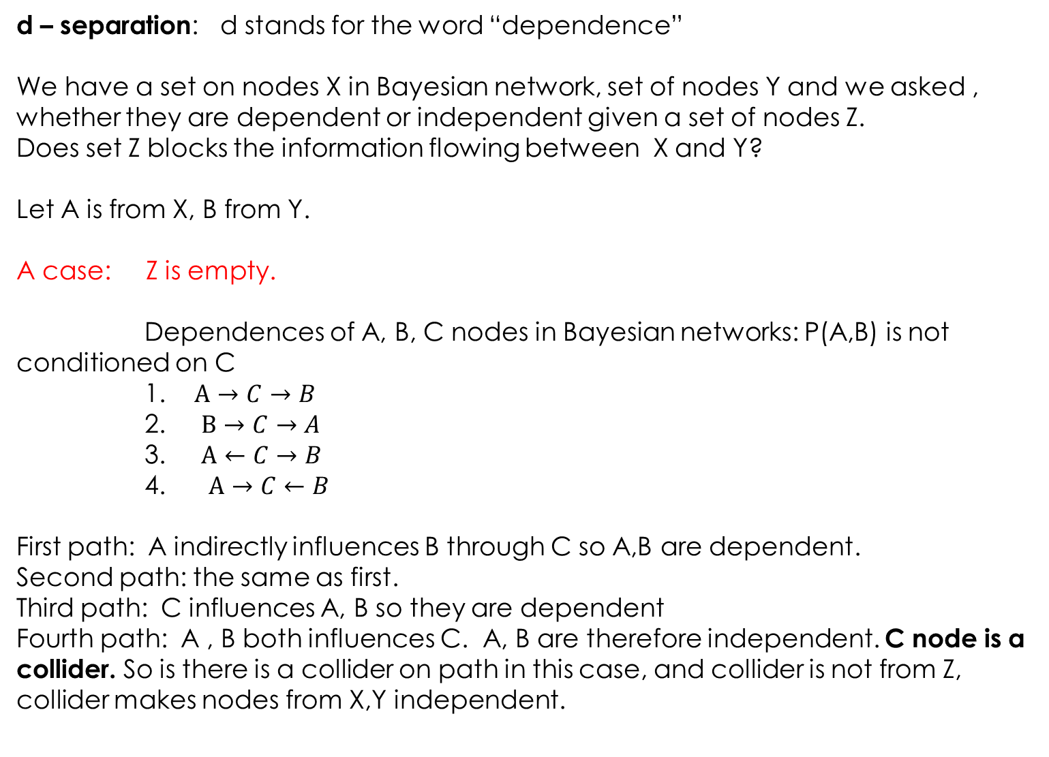
d – separation: d stands for the word “dependence”
We have a set on nodes X in Bayesian network, set of nodes Y and we asked , whether they are dependent or independent given a set of nodes Z.
Does set Z blocks the information flowing between X and Y?
Let A is from X, B from Y.
A case: Z is empty.
Dependences of A, B, C nodes in Bayesian networks: P(A,B) is not conditioned on C
1. $A→C→B$
2. $B→C→A$
3. $A←C→B$
4. $A→C←B$
First path: A indirectly influences B through C so A,B are dependent.
Second path: the same as first.
Third path: C influences A, B so they are dependent
Fourth path: A , B both influences C. A, B are therefore independent. C node is a collider. So is there is a collider on path in this case, and collider is not from Z, collider makes nodes from X,Y independent.

Slide 16
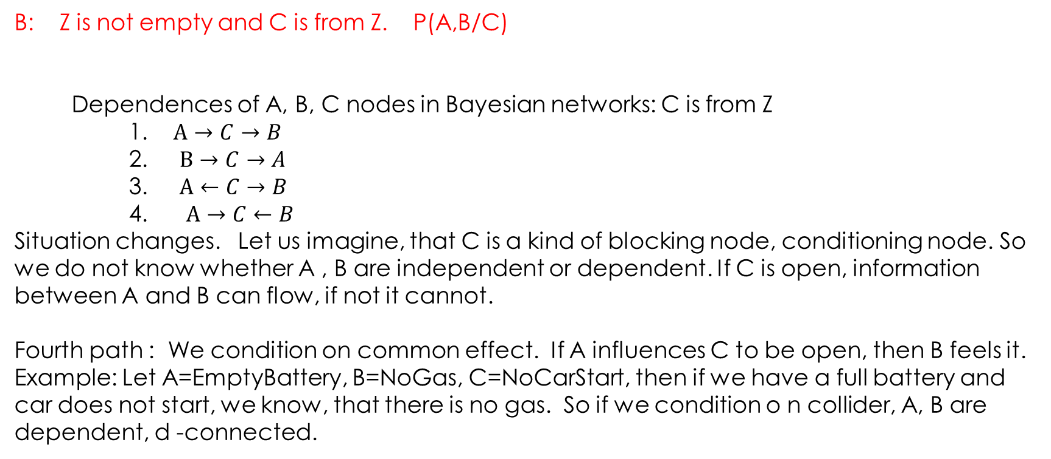
B: Z is not empty and C is from Z. P(A,B/C)
Dependences of A, B, C nodes in Bayesian networks: C is from Z
1. $A→C→B$
2. $B→C→A$
3. $A←C→B$
4. $A→C←B$
Situation changes. Let us imagine, that C is a kind of blocking node, conditioning node. So we do not know whether A , B are independent or dependent. If C is open, information between A and B can flow, if not it cannot.
Fourth path : We condition on common effect. If A influences C to be open, then B feels it. Example: Let A=EmptyBattery, B=NoGas, C=NoCarStart, then if we have a full battery and car does not start, we know, that there is no gas. So if we condition o n collider, A, B are dependent, d -connected.

Slide 17
Algorithm
Draw an ancestral graph. That means draw a reduced version of B. net from the nodes mentioned in the probability expression,and all their ancestors (parents and parents of parents, etc).
Connect the parents. For each pair of variables with a common child, draw an undirected edge (line) between them. (If a variable has more than two parents, draw lines between every pair of parents.)
Repalce directed edges by undirected ones.
Delet the givens and their edges (In P(A/E,F) givens are E,F). Note that “given variables” as used here refers to the question “Are A and B conditionally independent, given D and F.
5. Find the answer in the resulting graph.
a) If the variables are disconnected, they are independent for sure.
b) If the variables are connected in this graph, they are not guaranteed to be independent. Note
that “are connected” means “have a path between them,” so if we have a path X-Y-Z, X and Z
are considered to be connected, even if there’s no edge between them.
c) If one or both of the variables are missing (because they were givens, and were therefore
deleted), they are independent

Slide 18
Examples:
Example 1. Are A and B conditionally independent, given D and F? (Same as “P(A|B,D,F) =? P(A|D,F)” or “P(B|A,D,F) =? P(B|D,F)”)
Draw ancestral graph
Conect parents.
A B
C
A B
C
D E
D
F
G
F
A B
C
D
F

Slide 19
Replace directed edges by the undirected ones.
Delete givens:
Read answer: A, B are connected so they are not required to be coditionally independent given D, F.
A B
C
D
F
A B
C

Slide 20
Example 2. Are D and E conditionally independent, given C?
A B
C
D E
A B
C
Make ancestal graph.
Connect parents.
D E
F
G
A B
C
D E

Slide 21
3. Replace oriented edges by unoriented.
4. Delete givens together with edges.
5. Read the answer. D, E are disconnected
therefore they are conditionally independent
given C.
A B
C
D E
A B
D E

Slide 22
Example 3. Are D, E independent (not conditionally independent, but only independent)?
Make an ancestral graph.
Connect the parents.
A B
C
D E
A B
C
D E
F
G
A B
C
D E

Slide 23
3. Disorient the graph.
4. Delete givens (there are no givens).
A B
C
D E
A B
C
D E

Slide 24
4. Read the answer : No, D and E are connected (via a path through C), so they are not required to be marginally independent. We cannot guarantee they are independent.

Slide 25
Introduction to the time series
Outline
Time series - definition
Time series - examples
Patterns in the time series and their identification.
Analysis of the trend.
We recognize classical time series and nonlinear time series analysis. Here, we deal only with the classical time series analysis.

Slide 26
Time series definition
Time series is defined as a sequence of values of certain variable measured in time. Measurements are usually (not mandatory) done in an equivalent time intervals. We suppose, that the measured values have certain internal structure, which can be identified by the time series analysis using an appropriate methods. No structure is of course found, if we deal with a white noise. But in reality we often do not.
Reasons for the time series analysis:
1. To understand underlying processes producing the measured data.
To create a model enabling one to predict future time series development, and also a feedback control if necessary.

Slide 27
Time series and their patterns- example
measurements
trend
periodic pattern, seasonality
randomness
time

Slide 28
Application of the time series theory and methodology in AI and in praxis
forecasts in the economic time series development, such as Dow -Jones index development in time, or other economic parameters
forecast of any measured time dependent variable development with time
forecast of the stock market behavior
- forecast in the price development
climatic forecasts based on the long time measurements
- feedback control of the processes, for example in robotics
- parameter estimations, in the case we are not able to measure them
- etc….

Slide 29
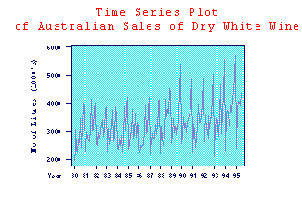
More time series examples
Example of the „well behaving“ time series with well defined trend and multiplicative periodicity (or cyclic part)

Slide 30
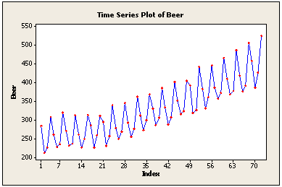
Example of the „well behaving“ time series with well defined trend and additive periodicity (or cyclic part)

Slide 31
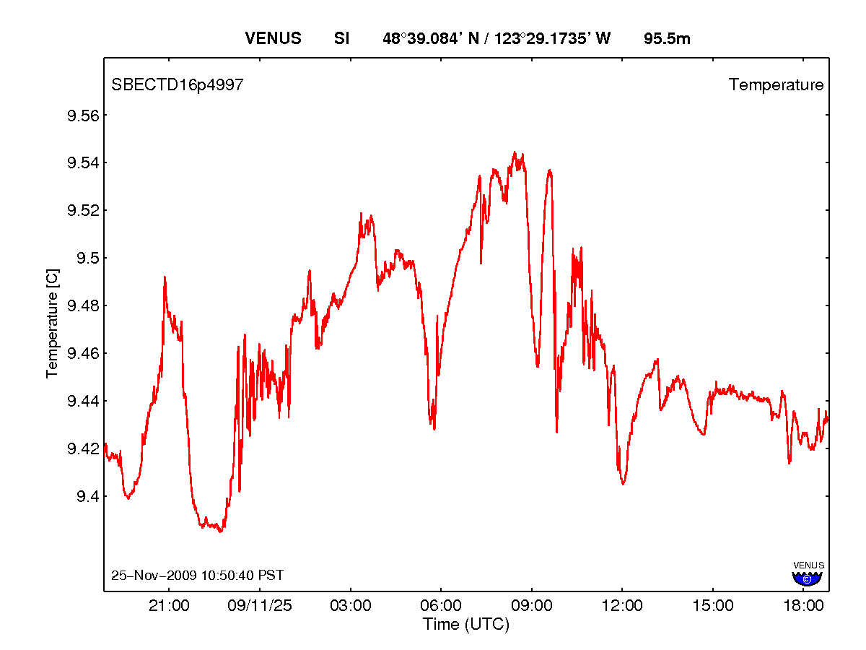
More complex time series with evident structure, but here is difficult to find trend and periodicity.

Slide 32
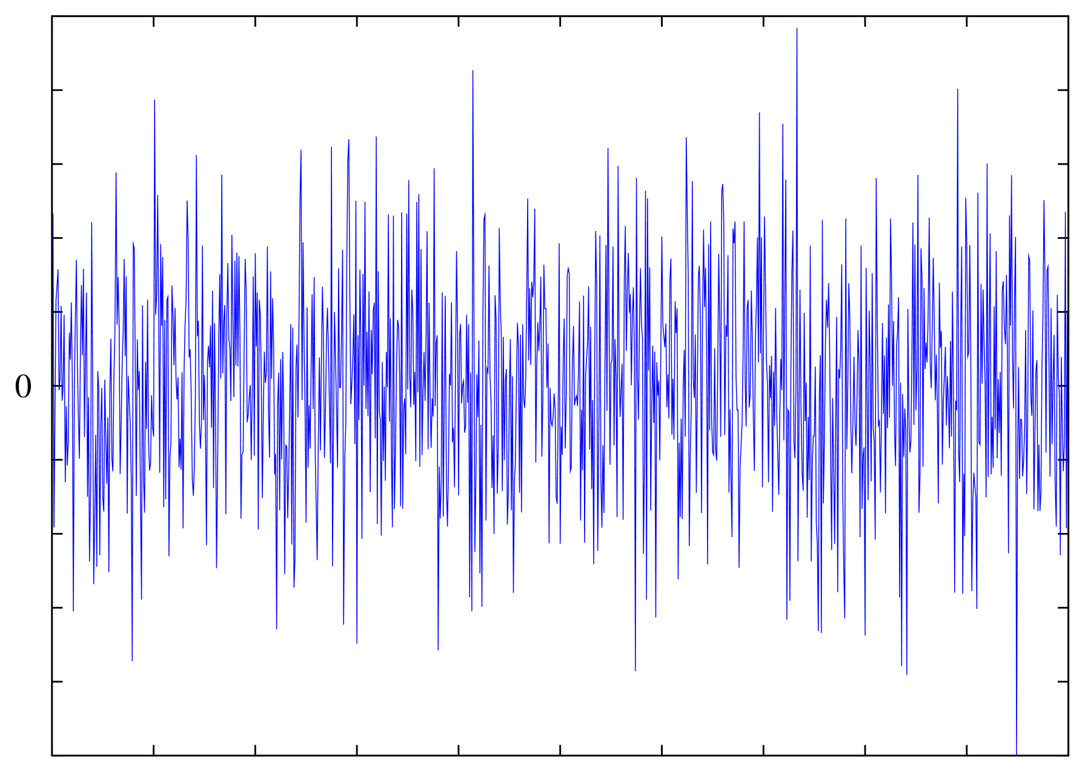
Poloha peľového zrnka v kvapaline
čas
White noise. Time series with no structure.

Slide 33
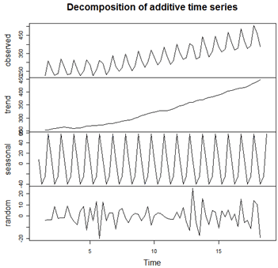
What is the task of the time series analysis?
1.
To create a model of the time series, to make predictions and other analysis.

Slide 34
What patterns are identified in time series?
Trend – systematicaly slowly changing pattern in time series (linear or nonlinear), not repeated in a data. Examples. Exponential growth, linear decrease of time series values with time.
Seasonality, periodicity- pattern which is systematically repeated in the time series after some fixed time. It is a quick (in comparison with the trend) change of the time series.
Cyclic pattern- quick systematic changes of the time series, where the period of changes is not fixed, but changes.
Rezidual pattern – random changes, rest after removing previously defined systematic patterns.

Slide 35
Examples of the time series
Example 1: Sale of some product grows linearly with time, but also has some seasonal changes having maximum before Christmas and minimum in january.
Example 2: Cycles in economy – economical growth and decline alternate each 5 to 7 years.
Example 3: Cyclic fashion changes…etc.

Slide 36
Analysis of the trend
1. Smoothing of the data – if the data are too noisy
- averaging methods (moving average)
- exponential smoothing
2. Function fit – we can try to approximate the trend by some
linear or nonlinear function

Slide 37
Averaging and smoothing methods
Manager in the supermarket measured how many dollars (in hundreds) average customer pays per month
1. 9 7. 11
2. 8 8. 7
3. 9 9. 13
4. 12 10. 9
5. 9 11. 11
6. 12 12. 10

Slide 38
-smoothed data
-real data
-real data average
Lines are guides to the eyes
11
9
7
Sale (money).
month
2
4
8
10
12

Slide 39
Comment
If there is a trend in a data, simple averaging does not show it. We get a number and that is. We need more refined methods to find a hidden structures. In next slides we deal with the trend. There based, in principle, on averaging of a data in some time window.

Slide 40
Single moving average (MA, SMA)
We average smaller set of the data as we move through the series using a window of certain length (for example 3 time units)
We replace the data in a window by the average, this simultaneously smoots the data
smoothed value at the time t
Measurements at t-i
N – window lenght
MA is able to detect simple trends, such as linear.

Slide 41
Single moving average - grafically
Y(t)
t

Slide 42
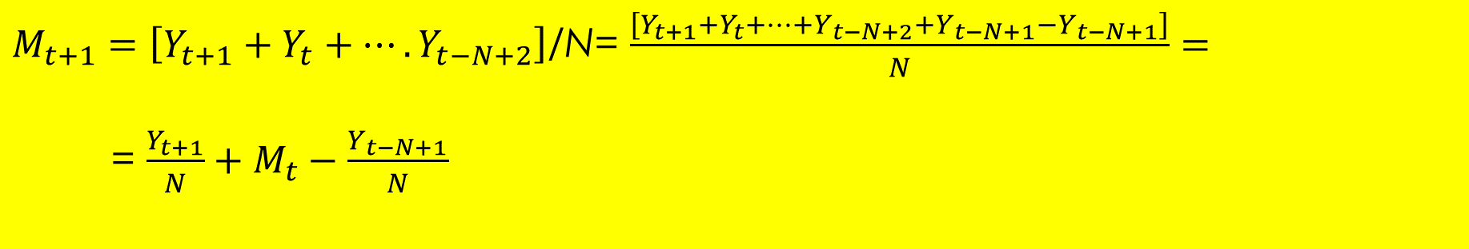
Why in MA we need not to calculate the average from all of the data in the window? How to calculate knowing ?
$M_{t+1}=\left[Y_{t+1}+Y_{t}+….Y_{t−N+2}\right]$/N= $\frac{\left[Y_{t+1}+Y_{t}+…+Y_{t−N+2}+Y_{t−N+1}−Y_{t−N+1}\right]}{N}=$
= $\frac{Y_{t+1}}{N}+M_{t}−\frac{Y_{t−N+1}}{N}$
Another version of MA is, that we take the same number of the measuremands forward and backward. This MA is called CMA central moving average.

Slide 43
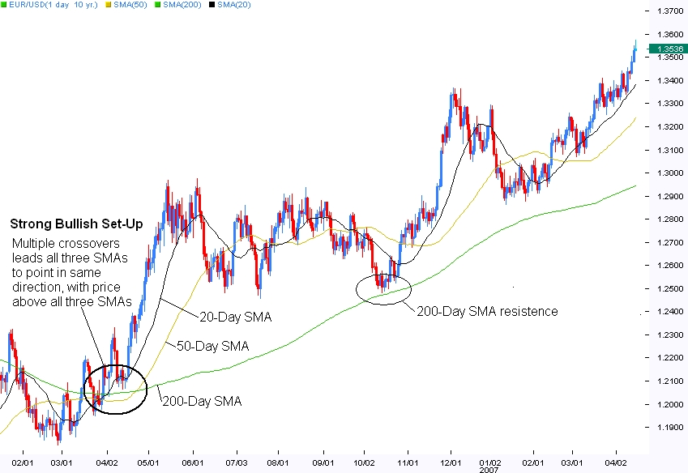
MA with the window lenght 20, 50 and 200 time units to the past.

Slide 44
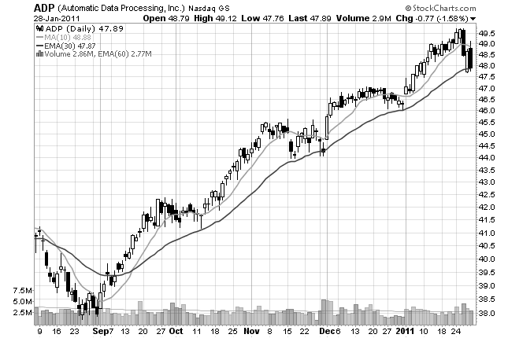
Here we see MA with the window 10 days (quick MA) and MA with the window 30 days(slow MA). Crossover points of the slow and quick MA is a trend change indicator. Look at the previous fig too.

Slide 45
Double moving average (DMA) for the linear trends
DMA is the same as MA, but done from the data gained after the first smoothing of the measured data by MA.
DMA is mostly used to find linear trends, but there are programs able to predict the values one time unit further very well, and are able to classify other types of significant trends as well.
DMA: Resulting data, smoothed by the first MA are smoothed again by MA.
Problem: lack of the data after the first usage of MA

Slide 46
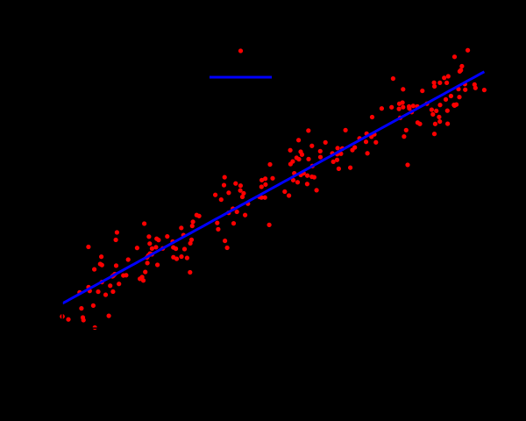
Linear trends
If we find, that after the smoothing procedure the trend in the time series is linear, we can approximate it by a line. The parameters are found with a help of linear regression.
Measurable value
y
Measured value with coordinates
Obr . 5. Time series with linear trend.
x(time for example)

Slide 47


Linear regression – with a help of this method we can approximate the measured data by a line with the parameters a,b.
Equation of a line with parameters a,b. To specify a line, we need to calculate the parameters.
Formulae for the parameter calculation. n is a number of measured data points, sum runs trough all of the measured data points.

Slide 48
Comment
Line approximating the data with parameters calculated by the above mentioned formulae is such that the mean square error is as small as possible. That is why it is a good linear fit to the measured data, even if the data are not linear.

Slide 49
Single exponential smoothing
Let us suppose that : , where b is a trend slowly changing with time and is an “error ”, changing quickly with time.
We calculate “moving average “ but supposing that the observations which are closer in time to the current time have greater weight, then the more distant observations..
is a smoothed value at the time t, is a smoothing constant and , , and y are observed , measured values.

Slide 50
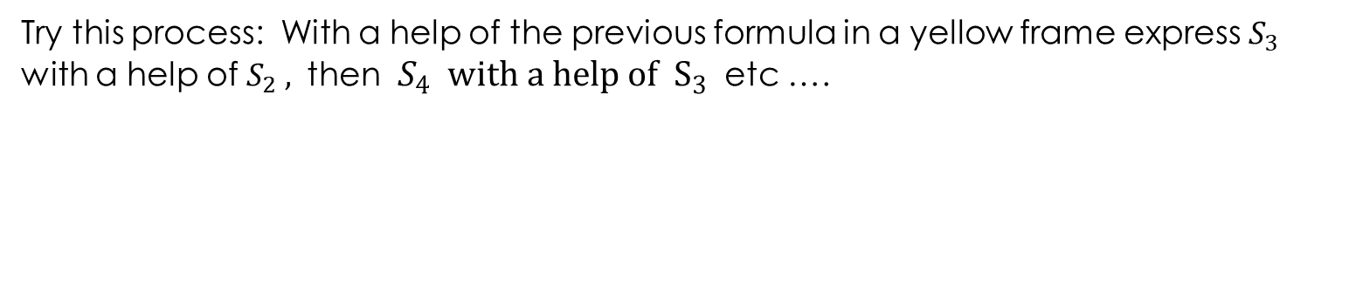
Why „exponential“ smoothing?
Try this process: With a help of the previous formula in a yellow frame express $S_{3}$
with a help of $S_{2} ,$ then $S_{4} with a help of S_{3}$ etc ….
Additions from the more distant measured values are exponentially decreasing.
Derive $S_{5}$ at home.

Slide 51
Advantage of the single exponential smoothing and estimate.
- SES is a best method for the one step forecast
estimate from the praxis: from the praxis it is for example known that alpha value around 0.3 is usually the best one for the series in question.
estimate from the data: we try values with certain step, we calculate the smoothed data and the mean square error . having the smallest mean square value is the best.
visual estimate: Plot the smoothed series (with the given ) together with measured values and compare visually. Good for the approximate estimate.

Slide 52
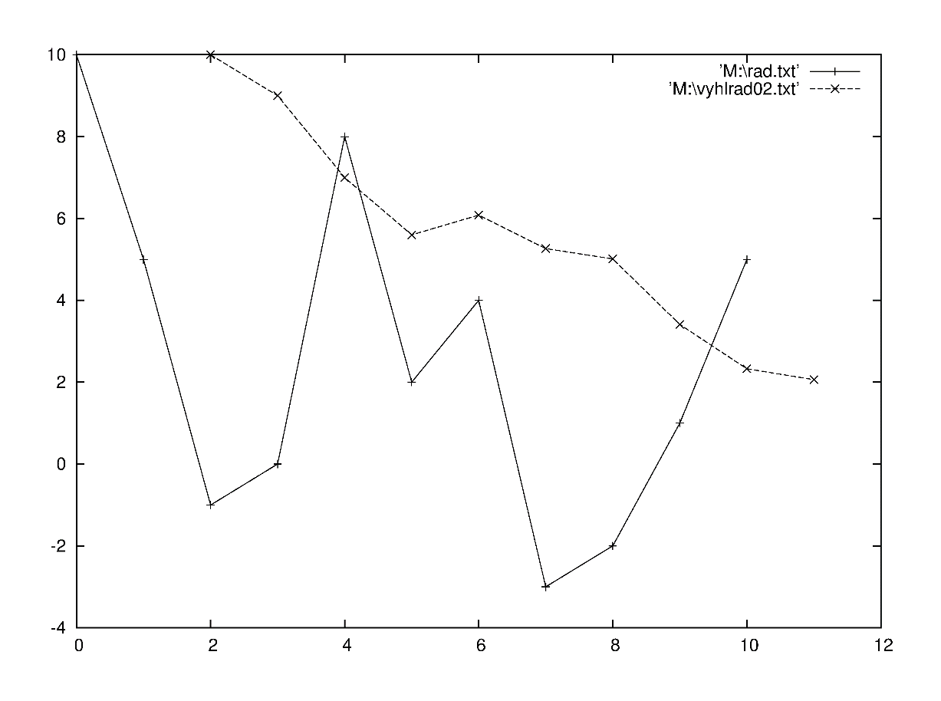

Example single exponential smoothing
Measured time series
10
5
-1
0
8
2
4
-3
-2
1
5
Error is the mean square error
error

Slide 53
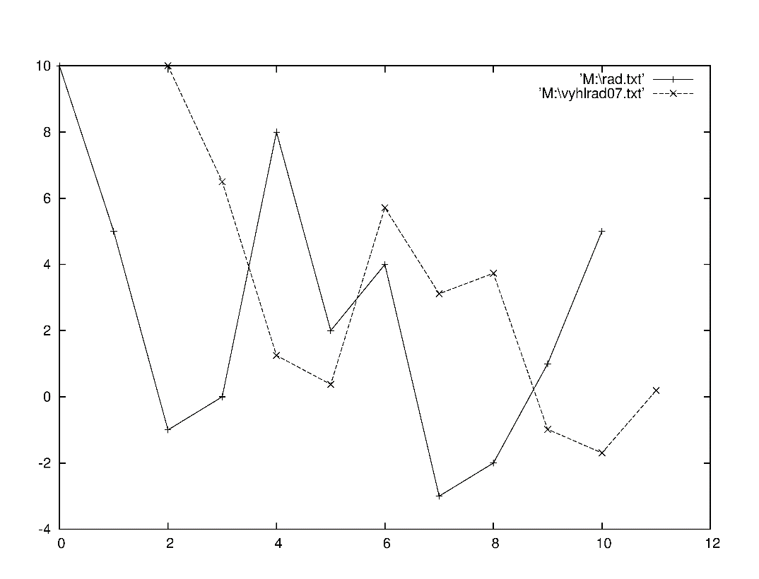

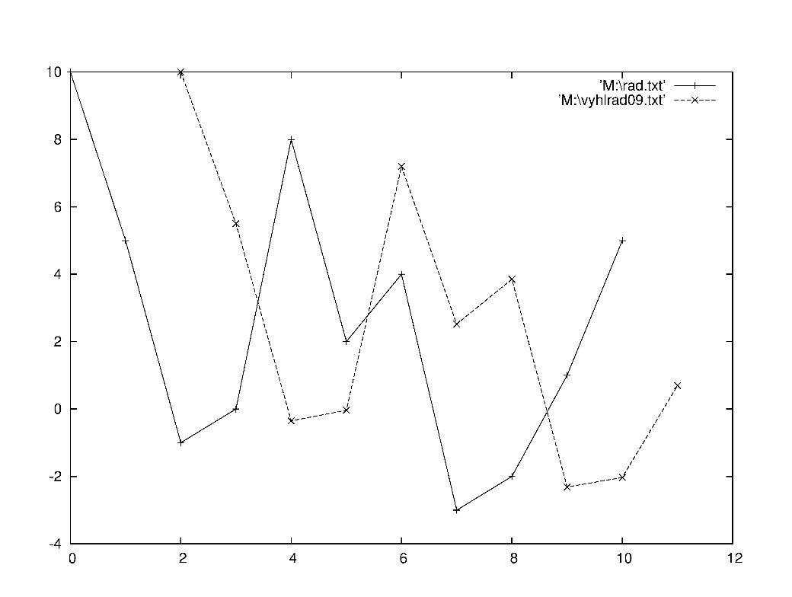

error
error

Slide 54
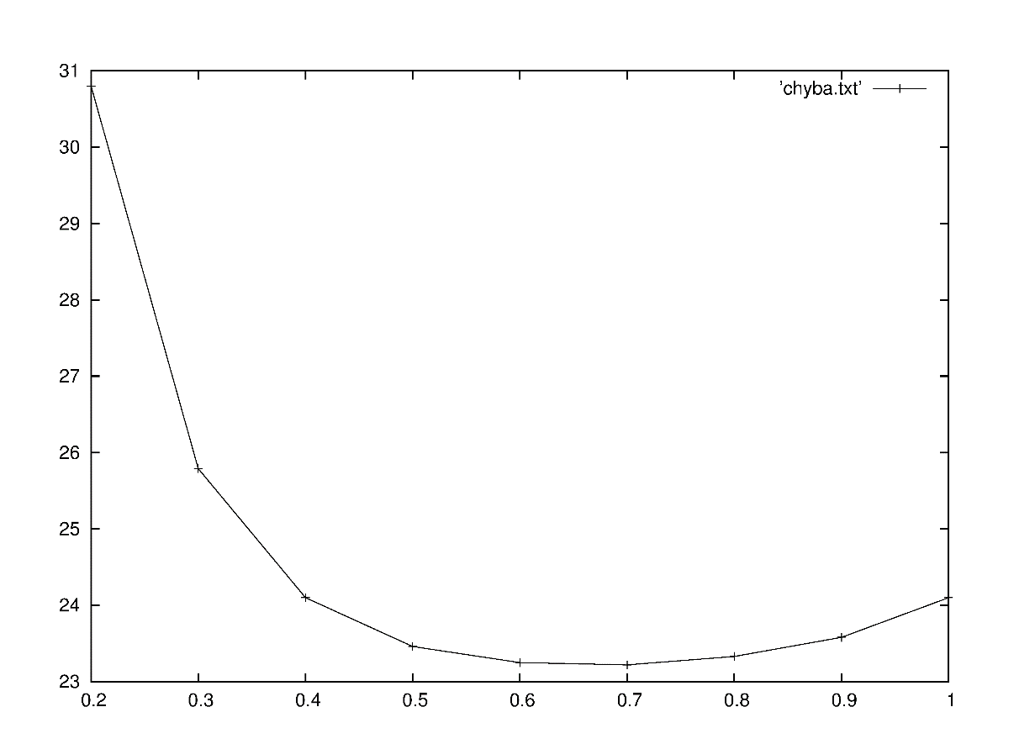
Dependence of the error on the α value.
chyba
error
minimum
alfa

Slide 55
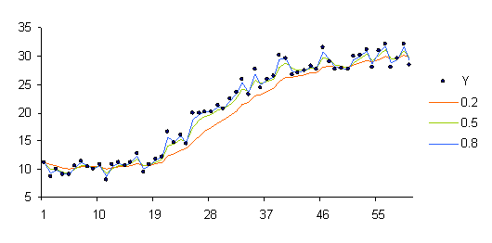
How SES works : measured data
alfa=0.2
alfa=0.5
alfa=0.8

Slide 56
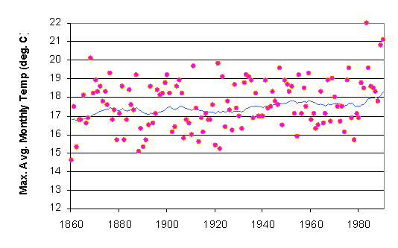
Temperature measurements in London through several tens of years. Each point exhibits an average monthly temperature.
Line : smoothed data

Slide 57
Double exponential smoothing (DES)
To the previous smoothed value one adds a trend at the time t-1
Update of the trend
- Different possibilities for the b choice.

Slide 58
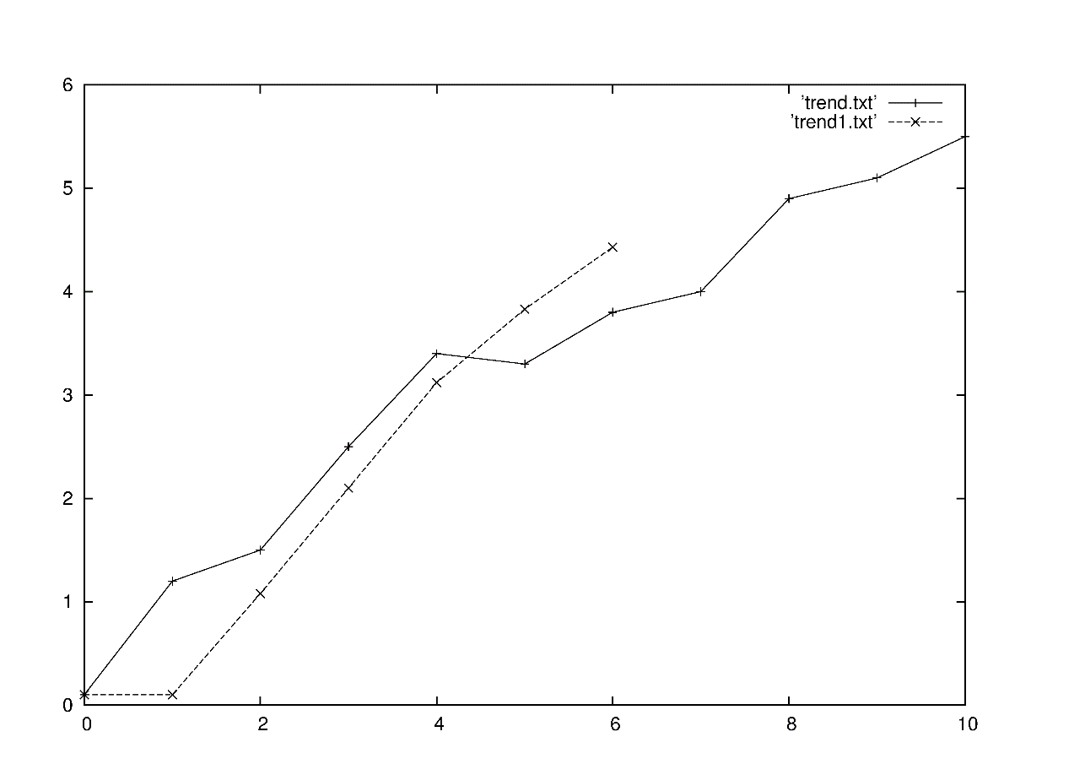
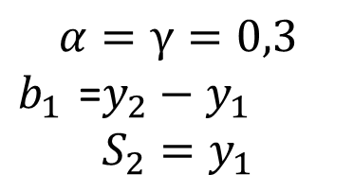
DES example
Initial conditions
Red points – time series
Black points – part of the smoothened series ).
Initial conditions can be chosen differently. For a long time series this is not that important, because the influence of the initial conditions on the values of the smoothed series decreases exponentialy.
Initial series
0.1
1.2
1.5
2.5
3.4
3.3
3.8
4.2
4.9
5.1
5.5

Slide 59
Forecast with the DES
One time step forecast
and are fitted. The best fit is the one giving the least mean square error
If there is a trend in the time series, DES performs better then SES.
m time steps forecast
DSE fits the trend better then SSE, because it is able to fit with the with lower mean square error

Slide 60
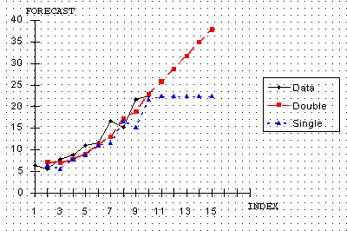
Forecasting - examples
Double exponential smoothing versus single exponential smoothing.

Slide 61
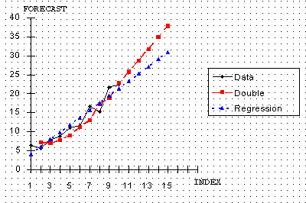
Double exponential smoothing versus linear regression forecast.

Slide 62
Periodicity (seasonality) analysis in the time series
Seasonal part in the time series:
1. Additive
2. Multiplicative
Aditive periodicity example : Sale (sum of prices) of a certain toy has a peak at December, but each year this peak price 1 million dollars is added.
Multiplicative periodicity example: Sale of some another toy has also peak at December, but this peak is each year multiplied by the factor 1.4.

Slide 63
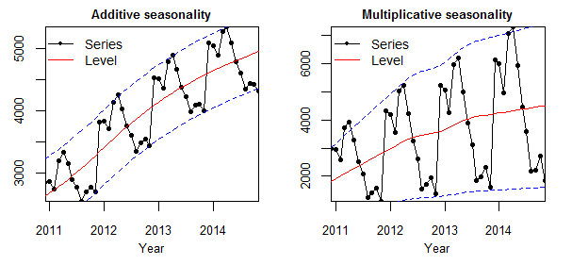
Additive versus multiplicative time series example (Nikolaos Kourentzes home page , Lancaster University)
Sale

Slide 64
How to reveal seasonality in time series?
Draw the time series in time, if there are some significant seasonal changes, they are visible by eye. We can see it even better if substracting the trend (if the type of the trend is known).
If the period of the seasonal changes is known, to draw one period might be useful, because one can see more refined seasonal changes. We can copy more periods one above the other and average. This procedure smoothens the noise. We can subtract the trend, smoothen the series etc.
Multiple box plot.
Find the dependence of the autocorrelation coefficient on the time interval.
Triple exponential smoothing .

Slide 65
Time dependence of the time series
To see how the time series behaves in time is the first step one need to identify. Then
- try to fit the series by some function
- try to smoothen the time series
- if there is a visible trend, try to find the trend and subtract it from the measured
data.
-draw the time behavior of the time series with the subtracted trend
-use triple exponential smoothing to fit the seasonal parts of the time series

Slide 66
Example how to deal with seasonality
Series: Two year measurement of how many lunches were sold in the school restaurant
1000
MA smoothing
500
100
Quarters of year

Slide 67
1. From the time behavior of the time series one sees, that there is a linear trend and a multiplicative periodicity.
2. Centered MA with the window a bit longer then the period smoothens the seasonal changes. Cyclic part, if there exists, is not usually touched. Fit the trend.
3. Subtract the trend and find an average multiplicative factor by coping January, February ….parts of the time series. Rescale and average the seasonal changes. The random part is inhibited by the averaging.

Slide 68
Seasonality in the complex time series.
concentation of certain chemical in the air
month
Heuristic knowledge: there are probable seasonal changings, but they are not easily visible

Slide 69
Summary
Time series – definition, structures
Trent in the time series – MA, double MA, exponential smoothing, double exponential smoothing.
Periodicity in time series, types of periodicity, additive, multiplicative.
Examples.

